Slide 1
#Unite Clubs Conference Update
Chris Moss
Head of Development and Participation

Slide 2
2020 A YEAR OF…

Slide 3
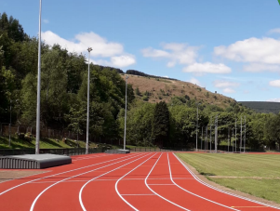
A LOOK BACK AT 2020…
An amazing response from the membership
#SupportYourClub
Webinars and Engagement
Online Qualifications and Education
An increase in Funding Applications
A positive year for facilities…
Launch of a new virtual club (Clwb Run Wales)
Hugely successful virtual Big Social Run
#FromMyDoor – national running campaign and launch of a ‘Plodcast’

Slide 4
SO WHAT DOES 2021 LOOK LIKE?
MORE…
Improvements and changes in relation to safeguarding
Support for volunteers
A focus on InSport and creating inclusive environments
A formal launch of the physical literacy programme (Starting Blocs) and structured junior offer
Club Modernisation and further support for clubs
A focus on growth and retention
A new era for Run Wales

Slide 5
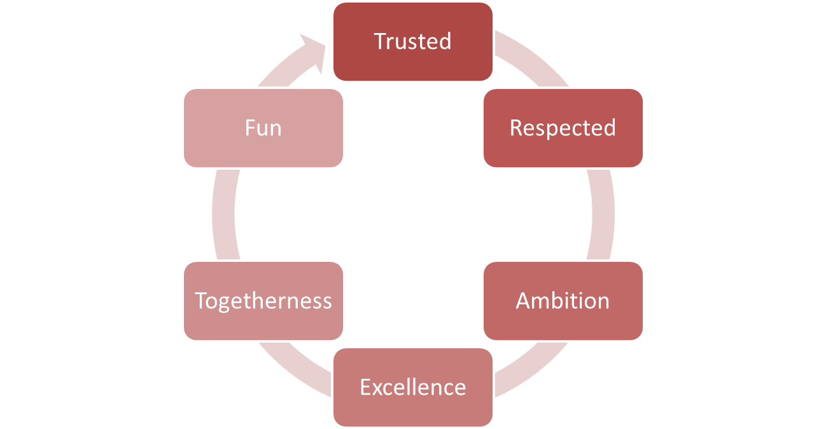
WELSH ATHLETICS: DEVELOPMENT TEAM PROMISES
We care
We are passionate
We are human
We don’t make mistakes deliberately!
We are always here to help (but you need to ask!)

Slide 6
THANK YOU

